Slide 1

Holy texts words analysis
IT-516-01
Professor Sean Harrington
Green Team:
Ernest Goodman
Sitanshu Mathukia
Greeshma Sree Katam
Xinwei Tang
Vinita Malhar Chinchwade

Slide 2
Introduction
Holy Books:
Most Sacred Texts Of Major World Religions.
Collection of atypical words or sources

Slide 3
Agenda
Project Overview
Technical overview
Statistics
Project Demo

Slide 4
Project Overview
Data Extraction
Statistics
Data Normalization
Graphs for data analysis
Data Collection

Slide 5
Technical overview
Data Source :
King-James-Bible (4.39 MB)
Babylonian-Talmud (9.62 MB)
Quran (3.39 MB)
Mahabhartha (14.4MB)

Slide 6
Classes
Ternary Search Tree
Regex
Frequency
StdDraw

Slide 7
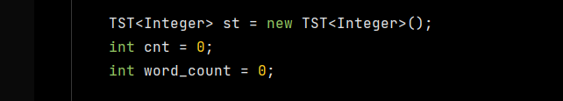
Ternary Search Tree
Symbol table with string keys, implemented using a ternary search trie (TST).

Slide 8
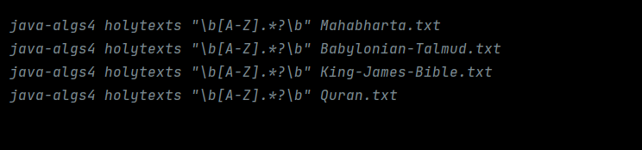

Regex
RegEx, which stands for "regular expressions," is a collection of characters used to form patterns that may be used to search, locate, replace, or validate text.

Slide 9
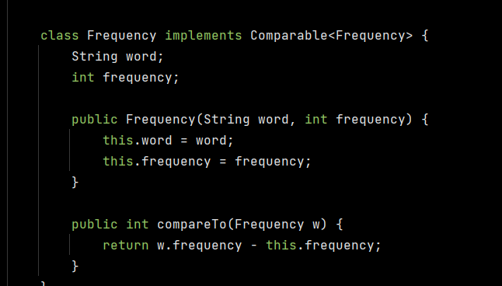
Frequency
Read strings from standard input and print the number of times each string occurs, in descending order.

Slide 10

StdDraw
Class provides a basic capability for creating drawings with your programs. It uses a simple graphics model that allows you to create drawings consisting of geometric shapes

Slide 11
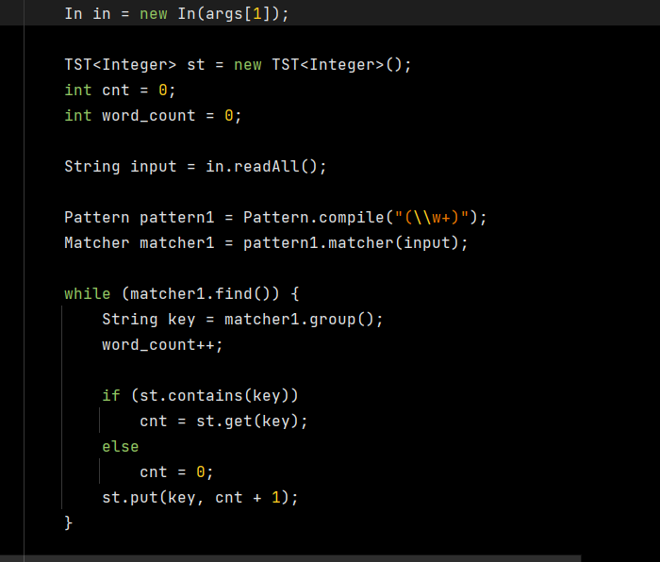
Statistics
Calculate total number of words

Slide 12
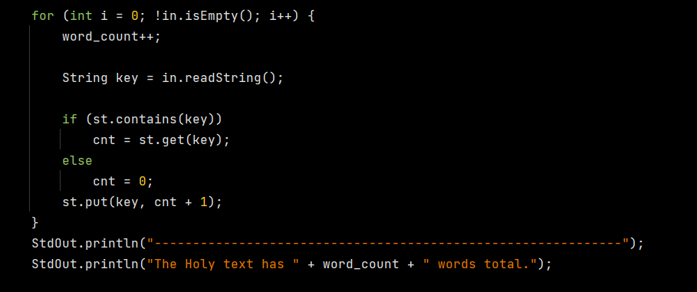
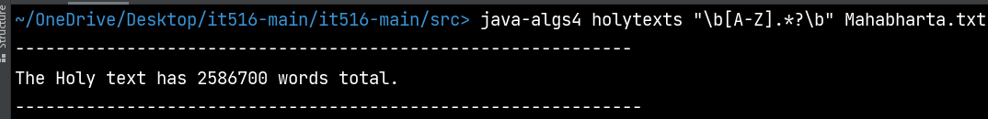
Statistics
Calculate total number of words
Output

Slide 13
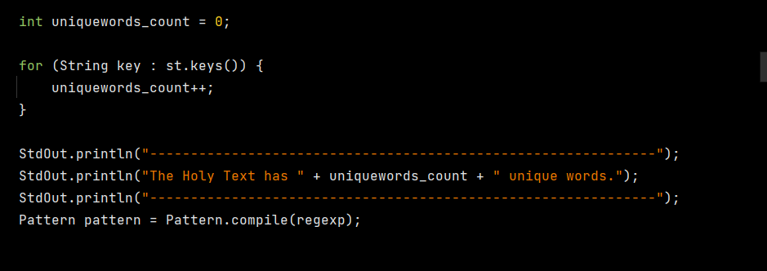

Statistics
Calculate unique number of words
Output

Slide 14
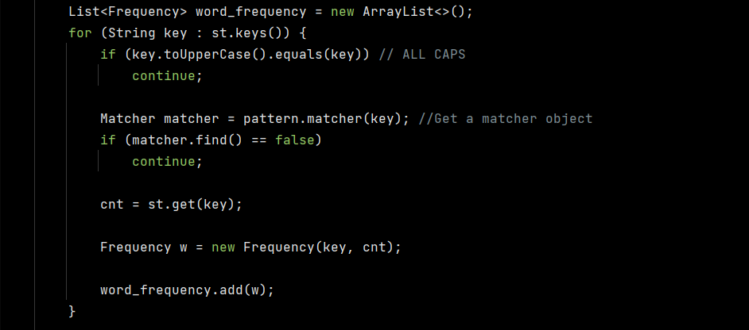
Statistics
Calculate Word Frequencies

Slide 15
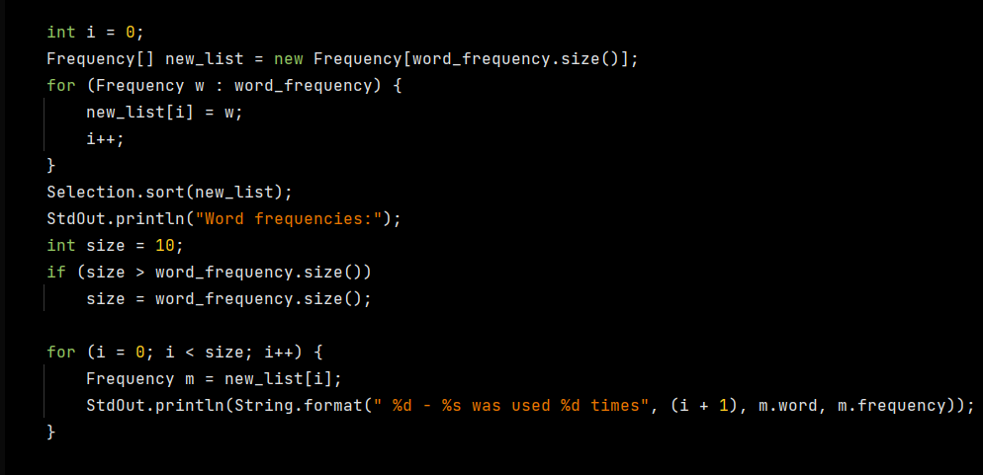
Statistics
Calculate Word Frequencies

Slide 16
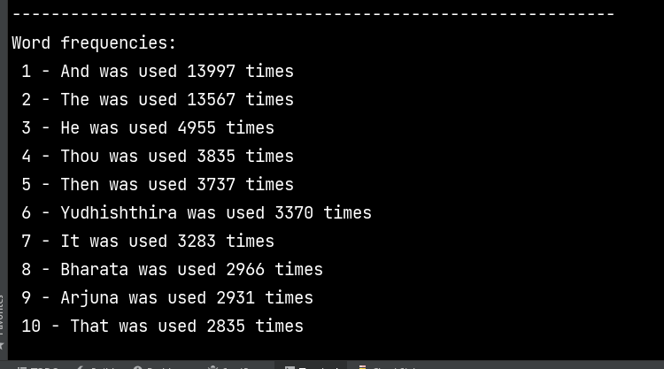
Output for Mahābhārata

Slide 17
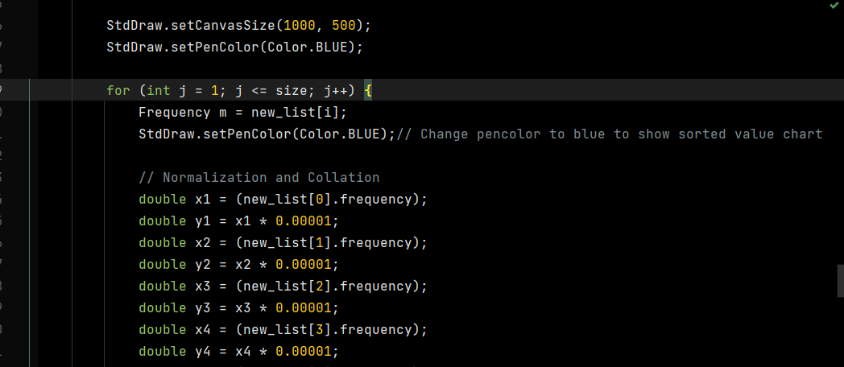
Graphic representation of the data
Normalization and Collation

Slide 18
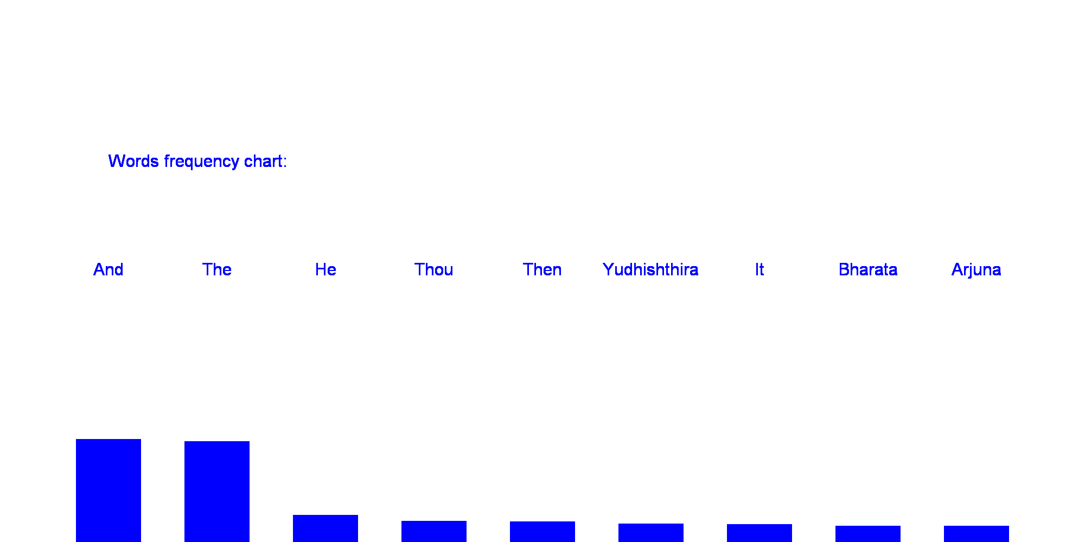
Graph

Slide 19
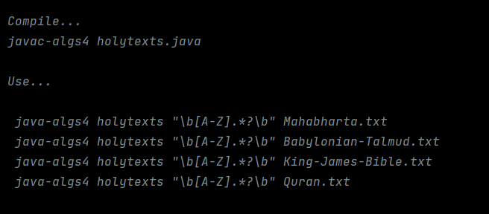
Project Demo

Slide 20
Thank you…

